Slide 2
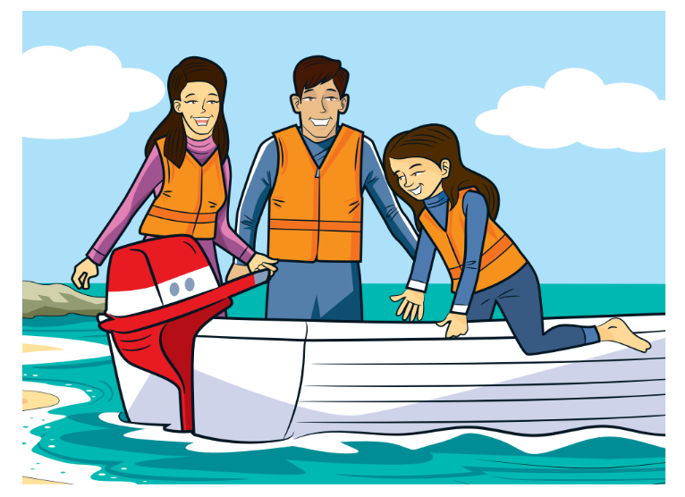
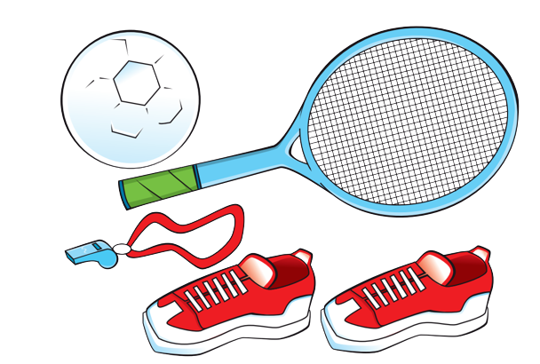
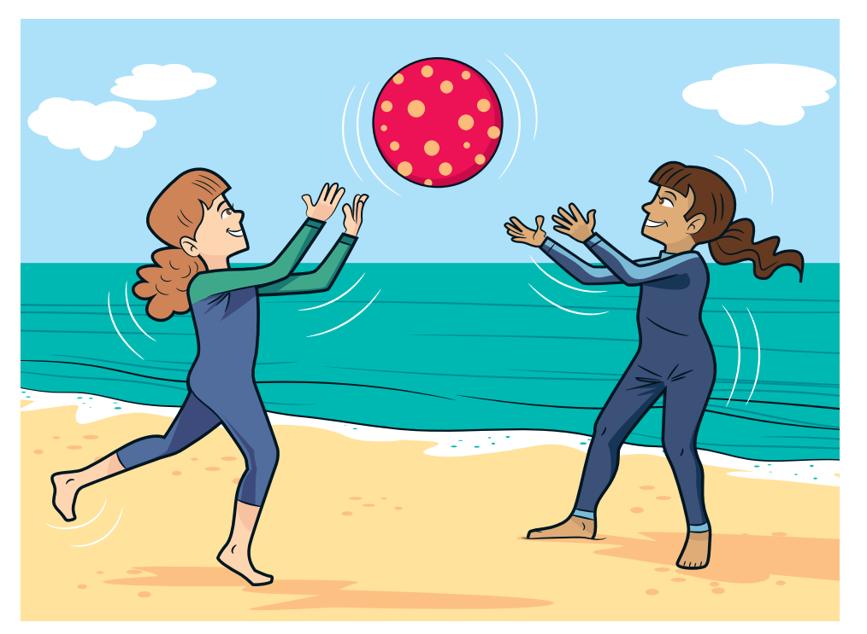
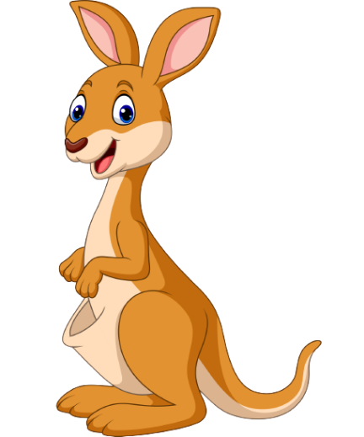
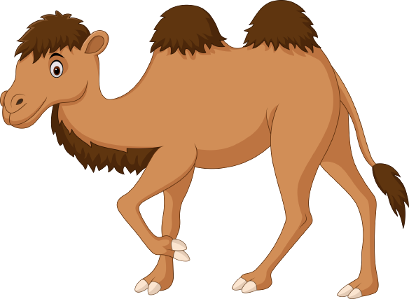
REVIEW 2
Period 2

Slide 3
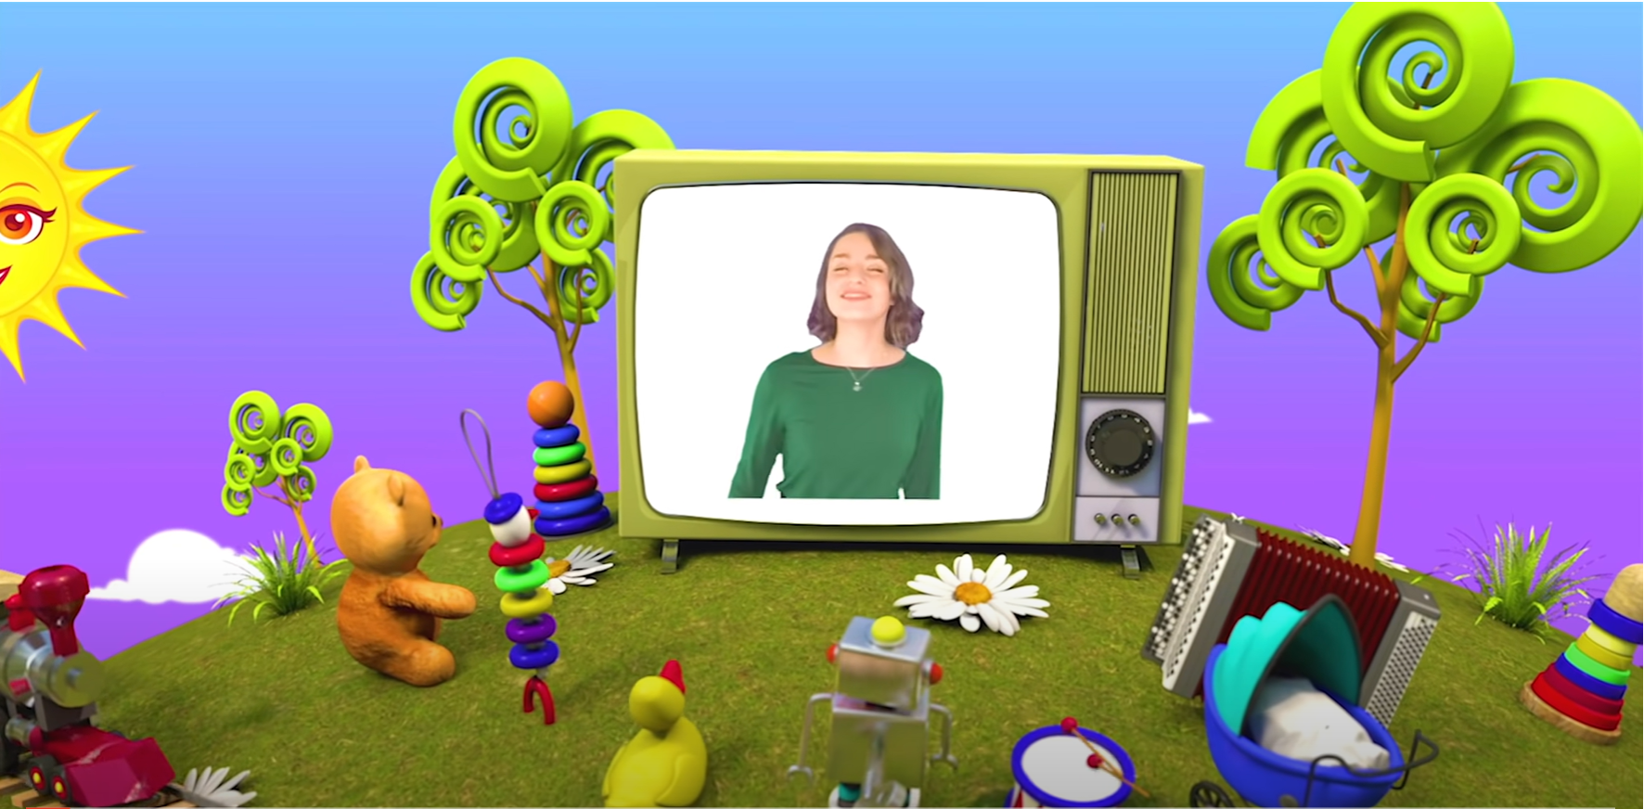
HELLO SONG
Notes:
https://www.youtube.com/watch?v=pqDEwPi7vxg

Slide 5
Game: BINGO
Notes:
* Game: “Bingo”
Ask the children to draw a three-by-three grid. In each of the squares, they write a different word from the vocabulary they have studied in the unit.
Call out words from the vocabulary in any order. Keep a record of the words as you say them, so that you don’t say the same word twice. The children cross off the words in their grids as they hear them. The first child to complete a line of three, shouts Bingo!

Slide 6
Good job!
Notes:
Point and Say

Slide 7
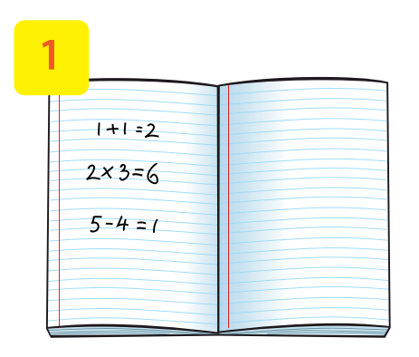
Look and Say.
math
Notes:
Ask the children to look at the picture and say the word.

Slide 8
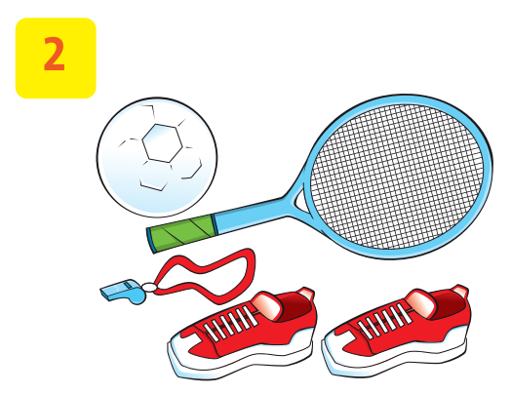
Look and Say.
P.E.
Notes:
Ask the children to look at the picture and say the word.

Slide 9
Look and Say.
Vietnamese
Notes:
Ask the children to look at the picture and say the word.

Slide 10
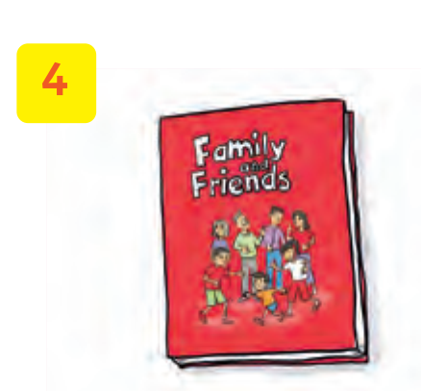
Look and Say.
English
Notes:
Ask the children to look at the picture and say the word.

Slide 11
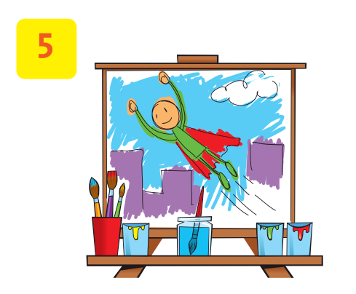
Look and Say.
art
Notes:
Ask the children to look at the picture and say the word.

Slide 12
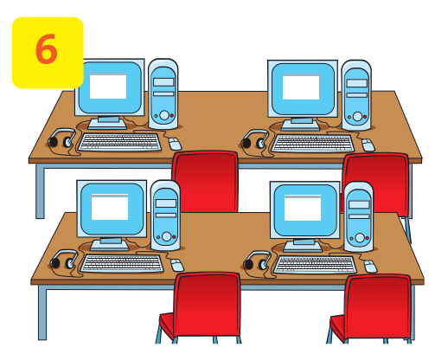
Look and Say.
computer room
Notes:
Ask the children to look at the picture and say the word.

Slide 13
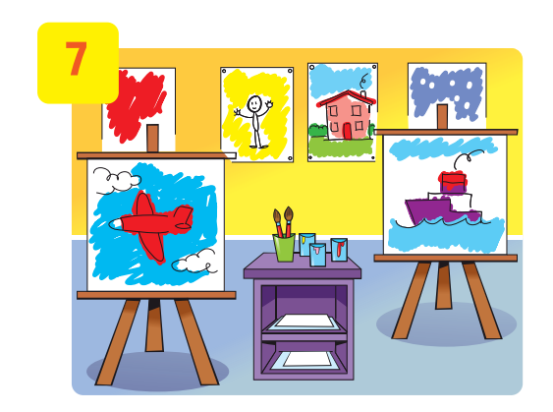
Look and Say.
art room
Notes:
Ask the children to look at the picture and say the word.

Slide 14
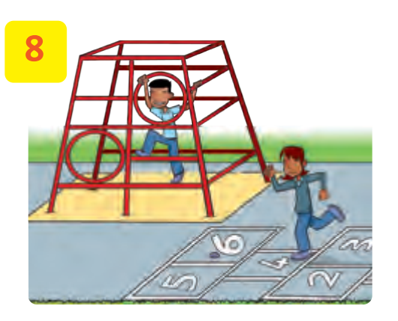
Look and Say.
schoolyard
Notes:
Ask the children to look at the picture and say the word.

Slide 15
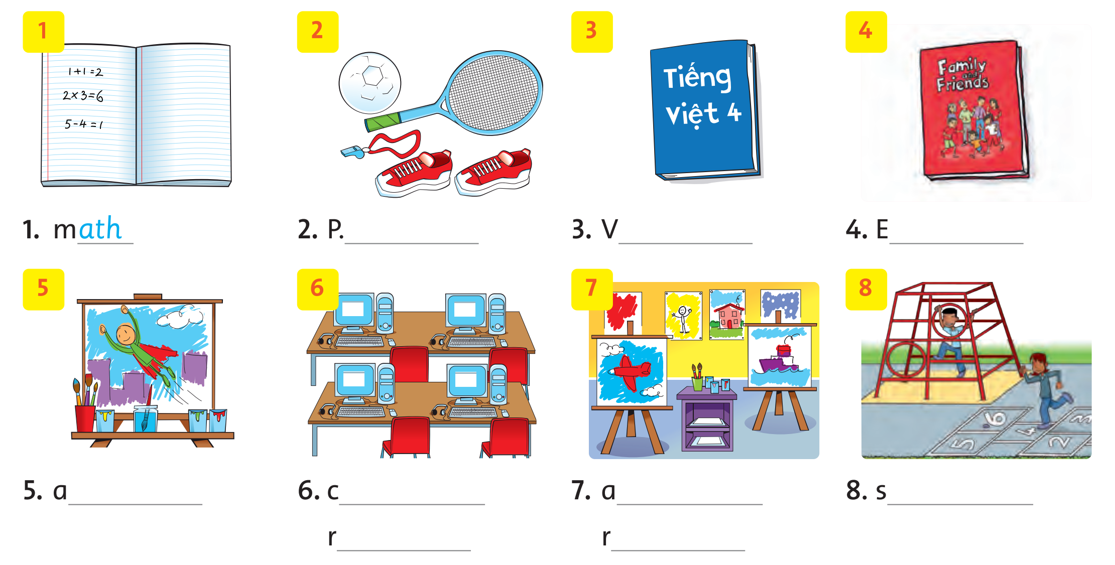
Look and Write.
ath
Notes:
* Look and write.
Show the pictures and the letters below them. Ask the children what the pictures show (school subjects and places).
Explain that the children will need to complete the names for each picture.
Show the first picture, ask them what it shows (math), and point to the example answer.

Slide 16
Look and Write.
ath
Notes:
Children complete the exercise.

Slide 17
Work in Pairs
Notes:
Ask two students to work in pairs to peer-check their answers and talk about the pictures.

Slide 18
Look and Write.
ath
Notes:
Children complete the exercise.

Slide 19
Look and Write.
math
P.E.
Vietnamese
English
art
computer
room
art
room
schoolyard
Notes:
Answer
1 math
2 P.E.
3 Vietnamese
4 English
5 art
6 computer room
7 art room
8 schoolyard

Slide 20
Good job!
Notes:
Point and Say

Slide 21
Ask and Answer.
What are the monkeys
doing?
They’re playing with a ball.
Notes:
* Look, ask, and answer.
Focus attention on the picture, then show the question and the example answer.
In pairs, children take turns asking and answering about what the animals are doing.
Answer
What are the lizards doing? They’re climbing the tree.
What is the zebra doing? It’s eating.
What are the kangaroos doing? They’re jumping.
What’s the crocodile doing? It’s sleeping.

Slide 22
Look and Write.
51
The monkeys are playing with a ball.
Notes:
Show an example. Children copy the example in their notebooks.

Slide 23
Look and Write.
51
Notes:
Children write sentences about what the other animals are doing.

Slide 24
Work in Pairs
Notes:
Ask two students to work in pairs to peer-check their answers and talk about the pictures.

Slide 25
Look and Write.
51
The zebra is eating.
Notes:
Invite the children to describe the animals.

Slide 26
Look and Write.
51
The kangaroos are jumping.
Notes:
Invite the children to describe the animals.

Slide 27
Look and Write.
51
The crocodile is sleeping.
Notes:
Invite the children to describe the animals.

Slide 28
Look and Write.
51
The lizards are climbing a tree.
Notes:
Invite the children to describe the animals.

Slide 29
Good job!
Notes:
Point and Say

Slide 30
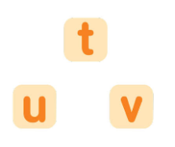
Think about the SOUNDS you have learnt.
Notes:
* Match the words with the same sound.
Ask the children to think about all the sounds they have learned so far.

Slide 31
Match the word with the same sounds.
Notes:
Ask them to match each word on the left with a word on the right that has the same sound.

Slide 32
Match the word with the same sounds.
51
Notes:
Ask them to match each word on the left with a word on the right that has the same sound.
Answer 1 d 2 a 3 b 4 c

Slide 33
Game: PASS THE BALL
Notes:
* Game: Pass the teddy bear
Explain how the game is played.
Give a teddy bear to one student.
Have students listen to music and pass the teddy bear.
Stop music suddenly.
Have the student with the teddy bear talk about his/her favorite school subject.
Continue the game until the time’s out.
Check students’ pronunciation. Praise students if they have done well.

Slide 34
Good job!
Notes:
Point and Say

Slide 35
Homework
Learn new words by heart.
Do the exercises in Workbook page 51.
Prepare for the next lesson
(Fluency 2- Period 1).

Slide 36
Our Winners!
Peter
Eric
Julie
Notes:
Replace photos and names with your students’ information.

Slide 37
Thank You!
See You Next Time.
Notes:
https://www.youtube.com/watch?v=SRyFiVeNjWs

